Slide 1
How to use GIT
DES - PTE
Qian Zhang
2026

Slide 2
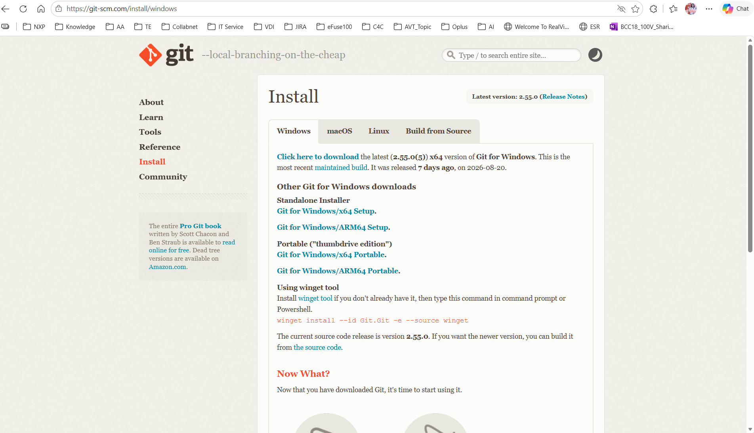
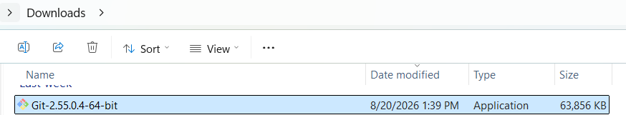
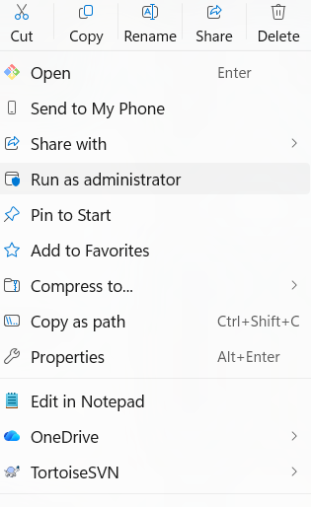
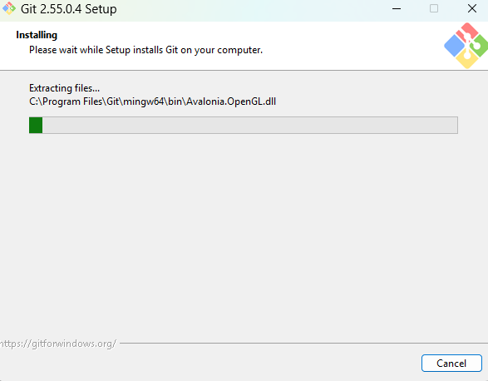

GIT - Installation
Go to Git - Install for Windows
1
2
3
4
5

Slide 3
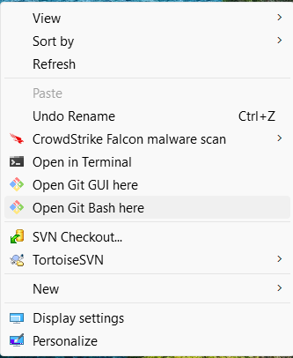


Git - Initial
1
2
3

